Slide 1
Query Optimizing Using Indexing In Mongodb
Group Name – TEAM-1895
Member Info:
1) Sri Harsha Velamakanni - 700688503
2) Ravi Teja Nigidala - 700678595
3) Venkat Reddy Konatham - 700678994

Slide 2
Introduction:
MongoDB provides complete support for indexes on any field in a collection of documents.
Without indexes, MongoDB must perform a collection scan, i.e. scan every document in a collection, to select those documents that match the query statement.
If an appropriate index exists for a query, MongoDB can use the index to limit the number of documents it must inspect.

Slide 3
Single Field Indexing:
As the name suggests single field index can only be created on one field.
Syntax:
db.collection.createIndex( { field: <type> } )

Slide 4
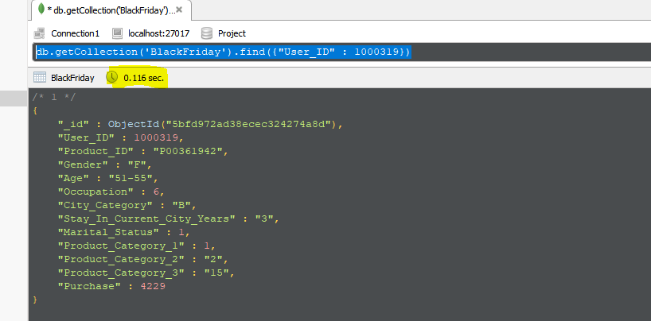
Without Indexing :-
Cost = 0.116 sec

Slide 5
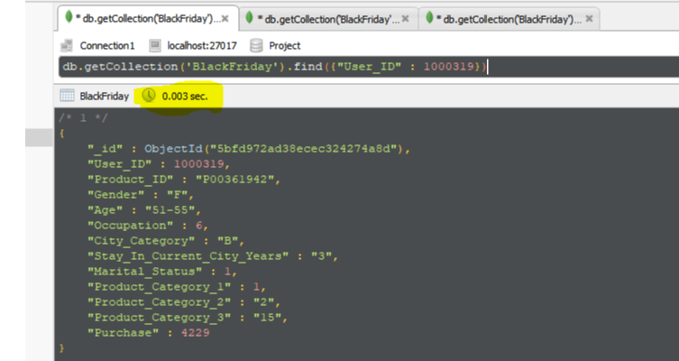
With Indexing (Single Field) : -
Cost = 0.003 sec

Slide 6
Compound Index:
When an index needs to be created on more than one field, compound index can be used.
Syntax:
db.collection.createIndex( { <field1>: <type1>, <field2>: <type2>, ... } )
The order of the fields is very important when creating a compound index.
The order should match with order of the fields in the query.

Slide 7
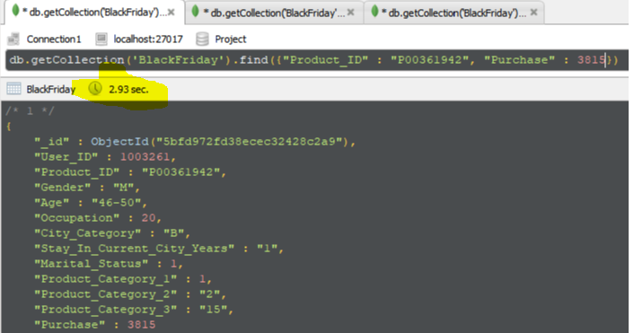
Without Compound Index:
Cost : - 2.93 sec

Slide 8
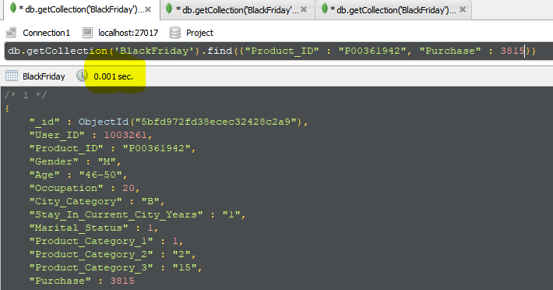
With Compound Index:
Cost :- 0.001 sec

Slide 9
Prefix of Compound Index
Example:
db.BlackFriday.createIndex({"Product_ID" :1,"Purchase" : 1})
In the above example “Product_ID” is the prefix
db.BlackFriday.find({"Product_ID" :” P00361942”})
The above query returns the result at the reduced cost as "Product_ID" is the prefix of the above compound index.

Slide 10
Dataset Used – Black Friday
The dataset is about study of sales through consumer behaviours
It contains observations about the black Friday in a retail store.
Link :
https://www.kaggle.com/mehdidag/black-friday
Collection: BlackFriday
No. of documents: 2687885

Slide 11
Columns:
User_ID - User ID
Product_ID - Product ID
Gender - Sex of User
Age - Age in bins
Occupation – Occupation
City_Category - Category of the City (A,B,C)
Stay_In_Current_City_Years - Number of years stay in current city
Marital_Status - Marital Status
Product_Category_1 - Product Category
Product_Category_2 - Product may belongs to other category also
Product_Category_3 - Product may belongs to other category also
Purchase - Purchase amount in dollars

Slide 12
References:
Text Book : Database systems concepts (by Abraham Silberschartz)
https://docs.mongodb.com/
Technologies:
MongoDB
Tools:
Robo 3T – 1.2 (for experiments)
Studio 3T (for importing datasets)

Slide 13


Slide 14


